Slide 1

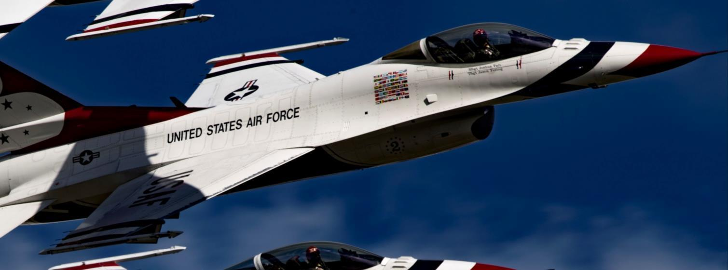

Welcome to
Air Force Financial Readiness
Retirement Planning Starter
Personal Financial Readiness

Slide 2

On the Horizon
Retirement: When a worker no longer receives any income from working.
Retirement can be voluntary or involuntary.

Slide 3

Agenda
Financial Planning for Retirement Starter
Your Vested TSP Account

Slide 4
Growth over Time

Slide 5



What Are You Planning For?
Financial
security
Long life
Fun
Make money now to fund all these things later.
Notes:
Animation – 1 click

Slide 6


How Can Compound Earnings Work for Me?

Slide 7
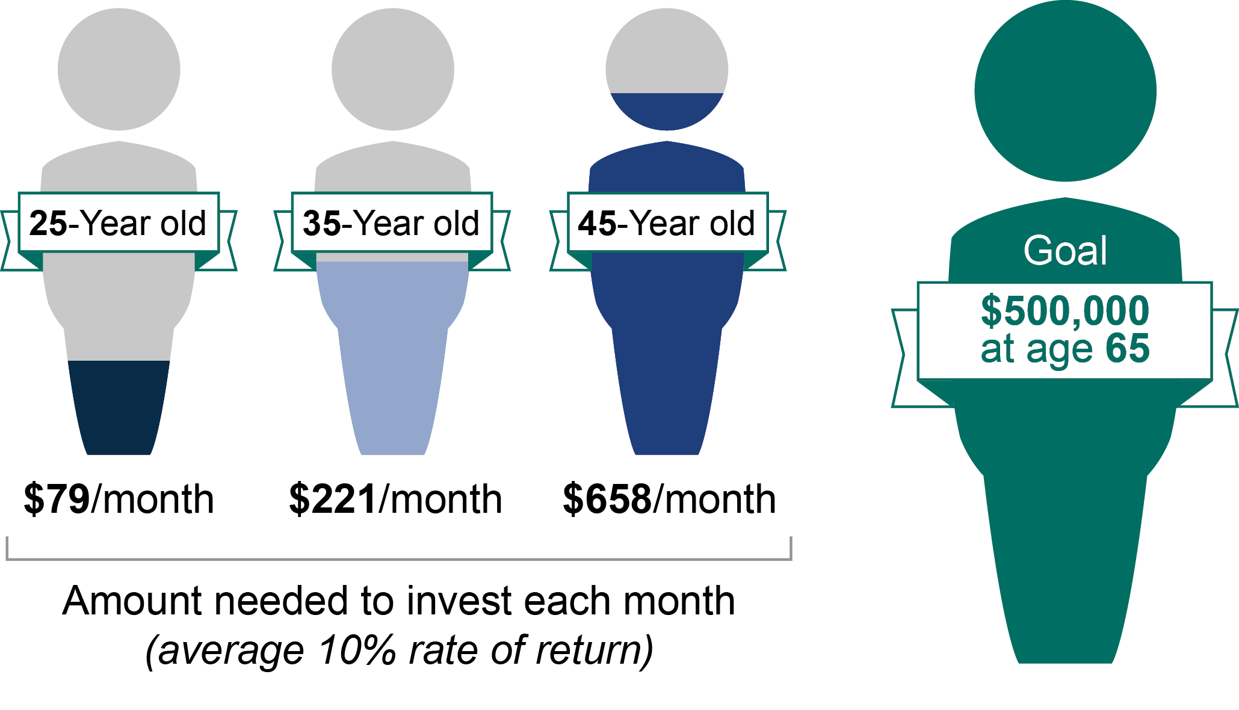
Compounding and Time
$500,000
at age 67
$154/month $324/month $735/month
Amount needed to invest each month
(average 7% rate of return)

Slide 8
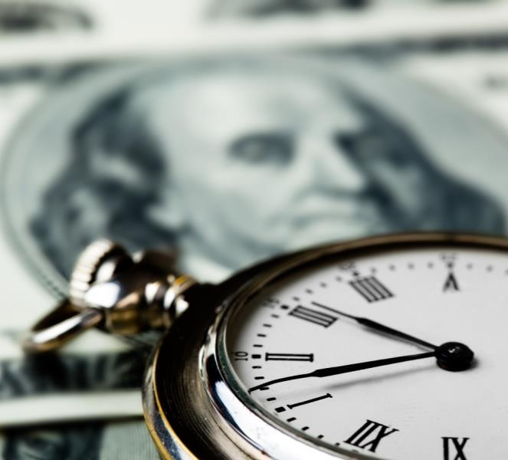
Rate of Return
On investment accounts:
7.0% +/-
On savings accounts:
1.5% +/-
Your TSP account can help
grow your retirement funds.
You must save and invest to reach retirement income goals.
Notes:
Animation – 4 clicks

Slide 9

What’s Your Goal?

Slide 10

Why Start Saving Now for Your Future?
Inflation erodes buying power of income
Prices rise steadily, about 2% per year
Earnings on savings and investments must beat inflation to maintain retirement lifestyle
Success in retirement takes planning
TSP can help
Notes:
Animation – 5 clicks

Slide 11
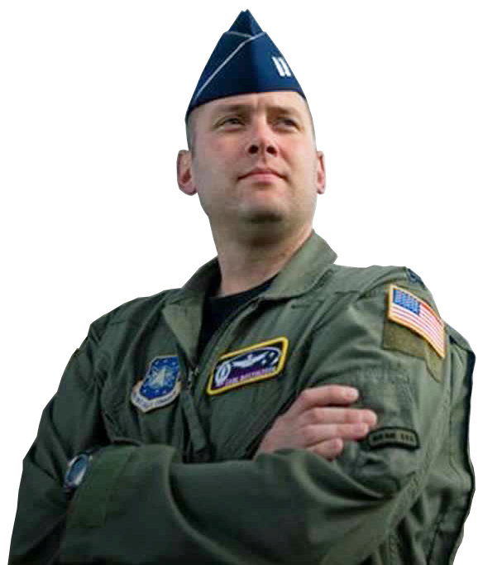
Summary
Planning for retirement
The power of compounding and time
Rates of return: Savings vs. Investing
Estimating financial resources for retirement

Slide 12
Your Vested TSP Account

Slide 13

Blended Retirement System (BRS)
  Defined-benefit pension of 2.0% of basic pay multiplied by years of service after 20 years
  Defined-contribution investments in TSP
    Service Automatic Contributions (1% of basic pay)
    Matching contributions up to 5% of basic pay after two years
    Voluntary contributions always belong to the service member, regardless of time in service

Slide 14

Thrift Savings Plan (TSP)
Retirement saving and investing
Like a 401(k) for federal employees and service members
Extremely low expense ratio
Vesting after two years
  All contributions belong to the account holder.
  Eligibility for matching contributions begins.

Slide 15

Lifecycle Funds

Slide 16
Matching contributions
E-4 with two years
Monthly basic pay: $2,307 (2020)
Annual basic pay: $27,687
You contribute | Amount withheld monthly | Service Automatic contribution* | Matching contribution* | Total monthly contribution (all sources) | Total yearly contribution (all sources) | Total percent of basic pay saved (all sources)
0% | $0 | $23.07 | $0 | $23.07 | $276.87 | 1%
1% | $23.07 | $23.07 | $23.07 | $69.21 | $830.52 | 3%
2% | $46.14 | $23.07 | $46.14 | $115.35 | $1,384.20 | 5%
3% | $69.21 | $23.07 | $69.21 | $161.49 | $1,937.88 | 7%
4% | $92.28 | $23.07 | $80.75 | $196.10 | $2,353.20 | 8.5%
5% | $115.35 | $23.07 | $92.28 | $230.70 | $2,768.70 | 10%
*Service Automatic and Matching Contributions are always deposited into the Airman’s TSP Traditional (pre-tax) account.

Slide 17
Where Will the Money Come From?

Slide 18


Contribution Choices
Pre-tax
(Traditional*)
Post-tax
(Roth)
*Service Automatic and Matching Contributions are always deposited into the Airman’s TSP Traditional (pre-tax) account.

Slide 19
Other TSP Advantages
Additional Contributions
Special and Bonus Pays
Rollovers
Notes:
Animation - 3 clicks

Slide 20

CAUTION

Slide 21
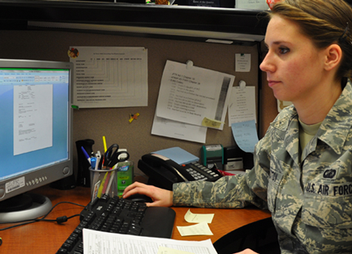
Managing Your TSP Account

Slide 22
TSP Funds
L Fund
“Lifecycle” Funds
Government Securities
G Fund
Bonds
F Fund
Common Stocks
C Fund
Small Cap Stocks (not in C)
S Fund
International Stocks
I Fund
Notes:
Animation – 6 clicks

Slide 23






Investing Beyond TSP
Education Savings Accounts
(Coverdell, 529)
Personal Stock Portfolios
Individual Retirement Accounts
(IRAs)

Slide 24
Revisit and Revise
Revise
Revisit

Slide 25

Review
Commit to regular, consistent saving and investing as a financial priority.
Maximize matching contributions.
Make additional contributions.
Make informed choices about TSP funds.
Shop wisely when investing beyond TSP.
Notes:
Animation – 5 clicks

Slide 26

Retirement Planning: Your Hole in One!

Slide 27

Conclusion
Evaluation and Certificates
Thank you!

